Slide 1
Evaluation of Palm Bay Academy’s Title I Program for FY21
Presented by: Michelle Allred Title I Coordinator

Slide 2
What is Title I?
Title I is a federal grant that:​
provides financial assistance to schools with high percentages of children from low-income families to help ensure that all children meet challenging state academic standards.​
assists with building capacity of parents and teachers; and​ encourages parents to be involved in their children’s education.
Funds come from the federal government through the state to districts.

Slide 3
What is the school’s allocation based on? (How much Title I money do we get and what can we spend it on?)
Title I funds for each school are primarily based on the number of qualifying students counted during what is called FTE week which occurs in early February the previous year.
These federal funds may be spent in three areas and the purchases must be above and beyond what the district/charter is already expected to be purchasing for students and teachers.
The three general areas that funds can be used to support are:
student achievement in the areas the school has identified as needing support/improvement
professional development (teacher trainings) to help teachers improve their teaching skills in the areas that have been identified as needing support/improvement
parent and family engagement activities to teach parents and caregivers to academically support their children at home or to assist parents with other needs that may influence their child’s academic success such as bullying or other behaviors.

Slide 4
What is the Title I Framework and Evaluation document?
This is one document that is partially completed at the beginning of the year with the plan for spending the funds and then the school goes back into the same document at the end of the year and fills in the results from each planned strategy/purchase. The document includes:
all school planned strategies/purchases using Title I dollars
planned strategies/purchases must support improvement in the areas that have been identified by the school’s comprehensive needs assessment activities (like this one).
a method to determine if the strategy/purchase made a positive difference in the area of weakness it was intended to strengthen.

Slide 5
Section 1 – Instructional Support (Lists the extra people that were hired with Title I funds to support students related to the weak areas that were identified in the school’s improvement plan.)
Spent a total of $249,600 (this includes all benefits such as FICA, insurance, workman’s comp., etc.)
4 Interventionists
This included 4 teachers that instructed small groups of students in reading during our “MTSS” periods. Some went into the classroom to support students in math. These teachers worked with Tier 2 and Tier 3 students and the goal was to move at least 15% to the next Tier.
.5 Reading Coach (the other .5 is paid by the district) and 1 Math Coach
The purpose of these positions is to promote enhanced academic instruction and student learning by coaching and working with teachers to develop more effective teaching practices and by sharing information addressing the way students learn. They hold data meetings to assist teachers in understanding and using diagnostic and test results to improve instruction.

Slide 6
Results - Kindergarten
 | Letter Names | Sounds | High Frequency Words | Concepts of Print | Phonemic Awareness | Oral Language Awareness | District Math Inventory
Beginning of the Year (averages) | Lower Case: 15 Upper Case: 17 | 7 | 0 | 7 | 3 | 3 | 12/20
End of the Year (averages) | Lower Case: 26 Upper Case: 26 | 26 | 58 (benchmark was 57) | 15 | 12 | 20 | 19/20
Notes:
Data can be presented many different ways. Choose a method that is easily understood by your stakeholders. You may want to add data slides when speaking to teachers in order to add more detail. Graphs are easily understood and that may be the best way to display data.

Slide 7
First Grade
 | Dorf | PSI | Running Records | Exact Path ELA Diagnostic | Exact Path Reading Diagnostic | Exact Path Math Diagnostic
Beginning of the Year | 14 | 2 | 3 | 800 | 826 | 728
End of the Year | 60 Benchmark is 60) | 6 (benchmark is 6) | 18 (benchmark is 18) | 855 (6.875% increase) | 871 (5.44% increase) | 832 (14.28% increase)

Slide 8
Second Grade
 | DORF | PSI | Running Records | Exact Path ELA Diagnostic | Exact Path Reading Diagnostic | Exact Path Math Diagnostic
Beginning of the Year | 49 | 5 | 15 | 830 | 870 | 794
End of the Year | 99 (Benchmark 100) | 8 (Benchmark 9) | 34 (Benchmark 30) | 860 (3.61% increase) | 973 (11.83% increase) | 860 (8.31% increase)

Slide 9
Third Grade
 | DORF | DAZE | Running Records | Exact Path ELA Diagnostic | Exact Path Reading Diagnostic | Exact Path Math Diagnostic
Beginning of the Year | 84 (Benchmark 83) | 9 (Benchmark 14) | 37 (Benchmark 30) | 905 | 962 | 852
End of the Year | 92 (Benchmark 112) | 14 (Benchmark 26) | 41 (Benchmark 40) | 979 (8.17% increase) | 1022 (6.23% increase) | 945 (10.91% increase)

Slide 10
Fourth Grade
 | DORF | DAZE | Exact Path ELA Diagnostic | Exact Path Reading Diagnostic | Exact Path Math Diagnostic
Beginning of the Year | 109 (Benchmark 121) | 16 (Benchmark 21) | 993 | 1038 | 935
End of the Year | 122 (Benchmark 146) | 29.5 (Benchmark 31) | 1065 (7.25% increase) | 1109 (6.84% increase) | 1004(7.37% increase)

Slide 11
Fifth Grade
 | DORF | DAZE | Exact Path ELA Diagnostic | Exact Path Reading Diagnostic | Exact Path Math Diagnostic | DORF | DAZE
Beginning of the Year | 98 (Benchmark 94) | 21 (Benchmark 21) | 983 | 1029 | 951 | 98 (Benchmark 94) | 21 (Benchmark 21)
End of the Year | 135 (Benchmark 133) | 24.35 (Benchmark 32) | 1061 (7.93% increase) | 1117 (8.55% increase) | 1026(7.88% increase) | 135 (Benchmark 133) | 24.35 (Benchmark 32)

Slide 12
Supplemental Resources (These are extra items purchased to help students and teachers be more successful in the areas the school identified as weak. This is in addition to materials provided by the district to all schools.)
Total Funds Spent: $49,300
$20,000: Exact Path and Study Island -instruction-online instructional component: Individualized lessons based on each student's diagnostic test. See Exact path results
$5,000: Phonics Workbooks - Phonics workbooks were used to enrich the learning of k-3rd grade students. See PSI, DAZE and DORF results
$4,000: Measuring Up ELA & Math Measuring Up - Employs real-world connections to engage students, presents the most tested standards, and provides scaffolded instruction that supports all learners and, more importantly, builds students’ confidence. See Exact path results
$2,000: SS Weekly - Studies Weekly is standards-based K-6 core curriculum for Social Studies, Science and Social Emotional Learning in a periodical and online format.
$17,000: Sadlier Supplemental Materials for Math and ELA. See Exact path results
$500: Charter Tools: Required by the district to help organize and keep accountable

Slide 13
Professional Development (These dollars are spent to improve teaching skills at the school which in turn should increase student success.)
Total Spent: $11,500.00
Leader in Me: $5,000 To improve instructional effectiveness and school culture allowing for an increase in learning gains
Columbia Teacher Training: $6,500 Designed to help teacher increase their skills in differentiation and overall teacher effectiveness. The Leadership team participated in additional professional development designed to help coach teachers effectively.

Slide 14
How does the school decide what to purchase with parent and family engagement funds?
The focus is to provide families with adult learning opportunities and materials focused on helping them help their children learn/practice at home. Funds must link to parent/family needs identified through the comprehensive needs assessment process (like this one). This is one of the areas that parent/family input is so important.
Examples of where the school gets their data from:
BPS District Parent Survey Results
Exit slips from parent/family events
Title I survey results
Input from parents that attended special meetings like this one (other input opportunities include School Advisory Council, Annual Title I meeting, Coffee with the Principal, … )
The following slides are examples of input from parents that we used to plan this year’s parent/family events.
If you would like to see a summary of each event’s exit slips, please contact Michelle Allred

Slide 15
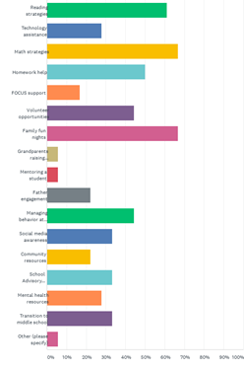
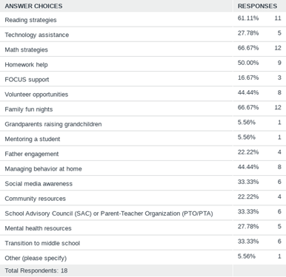
Parent Survey Data
Q11: Which of the following informational meetings and activities would you participate in or attend?

Slide 16
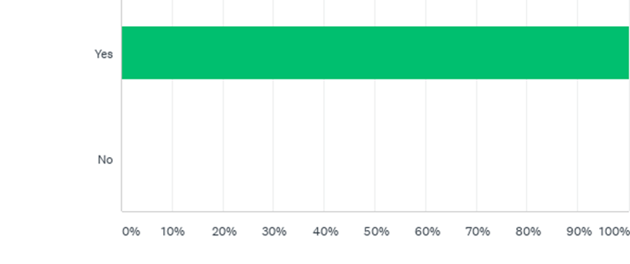
Parent Survey Data
Q6: Do you feel welcome at your child's school?

Slide 17
Parent and Family Engagement
Total Spent: $4,586.00
Culture and History Night ($500 spent) - Classes will present culture and history projects and performances prepared in collaboration with families. Funds will be used for books. Event created per parent survey results. Majority of families gave positive feedback and felt the activities were easy to understand and would be used at home.
Dr. Seuss's Birthday and Kinder Transition Event ($500 spent) - Virtual - Introduce incoming kinders to elementary school while celebrating Dr. Seuss. Middle School will host representatives from county high schools for Family Information Events. Funds for books, All families in attendance appreciated the explanations and materials to help them work with their child at home.
Readers of the Caribbean - ($500)Virtual Fun Family night focused on teaching the importance of reading and ELA activities at home. Students will receive books Event brought back due to parent and student request! This is a family favorite and our families gave overwhelmingly positive feedback!
Title 1 Annual Meeting - ($150 spent) Virtual - Introduce families to all aspects of Title 1, solicit parent input for all plans, work on the PFEP, present and discuss the Title 1 budget, work on Compact, talk about all resources available for family support through PBA Title 1 funds. Funds for Leader In Me books for parents.

Slide 18
Parent and Family Engagement
Winter Slumberland -($500 spent) Read Aloud Night for Families to explore all of the methods and benefits of adults sharing reading time with children. Funds for take-home books. Although this is a beloved event, parent feedback and lack of participation indicated that it might be time to look for something new in the coming year.
Turkey Trot Math Night - ($500 spent) Virtual stations of Common Core math games to educate families on fun ways to practice necessary math skills at home with their children. Funds for take-home math games and materials. Families really appreciate receiving the math manipulatives and flashcards - feedback was positive.
Family STEAM Night - ($1000 spent) Virtual with the Orlando Science Center- Families will learn and practice various STEAM activities and receive home directions and materials for STEAM projects.. Funds for demonstration and take-home STEAM projects. We love having the Science Center come out and this is one of our most popular events. Unfortunately, Title one funds will no longer pay forso we are creating a new event called “Star Party!”

Slide 19
Parent and Family Engagement
Dr. Seuss's Birthday and Kinder Transition Event ($500 spent) - Virtual - Introduce incoming kinders to elementary school while celebrating Dr. Seuss. Middle School will host representatives from county high schools for Family Information Events. Funds for books, information packets, All families in virtual attendance appreciated the explanations and materials to help them work with their child at home.
Leader in Me/Workshop for Parents - ($436 spent) Parents will learn 7 Habits and other strategies we are using at school and would like to transfer to home to reinforce positive behavior and goal-setting. Event created per parent survey results. Majority of families gave positive feedback and felt the activities were easy to understand and would be used at home.
Summer Reading Kick-Off - ($500 spent) Families will be presented with resources and books to encourage reading throughout summer. Information about summer educational activities in school and community will be provided. Funds for books.
All the input collected after each of these events is used along with the other input sources to decide what to do with the funds in the following year. Your input matters!

Slide 20
Summer Academic Intervention Plans (We also saved some of our Title I funds to support struggling students in June 2021)
Total Held for Summer Plans: $50,778
Pay nine teachers to provide summer school classes in math and ELA for students working below grade level (K-8).
Provide materials for summer school classes.

Slide 21
Other Possible Data Sources
District Science Assessment Data
Math Data
Attendance
Discipline
Insight Survey Results
District Parent Survey Results
Any other data you are basing decisions to drive improvement at your site

Slide 22
As a Valued Member (Stakeholder) of this school - We Need You…
to be part of our decision-making activities by completing the exit slip for this meeting/presentation. We use all input to determine our focus areas.
to tell us what you want us to spend next year’s Parent and Family engagement funds on that will help you to help your child at home.
to let us know we are doing that is working and what you feel we need to update, get rid of, or create new.
to be an active part of our school family.
All input is reviewed and considered by the Comprehensive Needs Assessment Committee.

Slide 23
How can I be more involved in decision-making at the school
The input we receive from our families is so important! We truly use it to build and improve our Title I program. Families provide valuable insight into how their children learn best! Remember, your opinion matters! Your voice in your child’s education is needed! This is a TEAM EFFORT!
Attend our events!
Complete exit slips at events and surveys that we send home! We read every single one and welcome positive and negative feedback!
Consider joining our School Board and PPL! We need to know what is working and what needs improvement at our school.
Share information and encourage other parents to get involved in school activities and planning.

